Slide 1
Electronegativity & Polarity
ELECTRONEGATIVITY & POLARITY

Slide 2
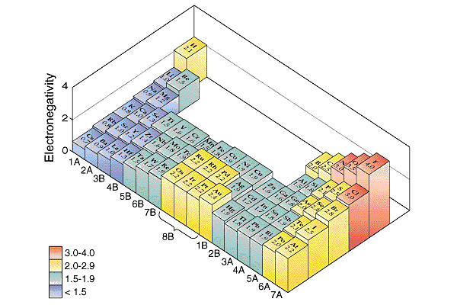
ELECTRONEGATIVITY
The electron attracting ability of an atom is called its electronegativity. The electronegativities of the main groups (ignoring the noble gases) increases to the right and upward.
Increasing Electronegativity

Slide 3
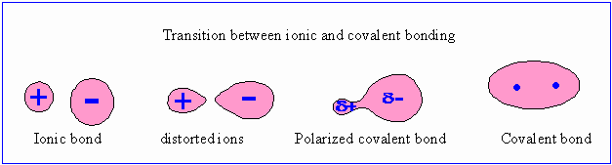
POLARITY OF BONDS
The difference in electronegativities of two elements can be used to predict the nature of the chemical bond. When metals and non-metals bond and ionic bond is formed since the tendency of the non-metal to take the metal’s valence electrons is high.
When 2 non-metals with different electronegativities bond an uneven sharing of electrons occurs and a polar covalent bond is formed. When 2 identical non-metal atoms bond an even sharing of electrons occurs and a non-polar covalent bond is formed.
Eg. NaCl Eg. AlCl₃ Eg. HCl Eg. Cl₂

Slide 4

POLAR BONDS v POLAR MOLECULES
Chlorine has a much greater electronegativity than hydrogen, hence the H – Cl bond in hydrogen chloride is a polar.
Since this is the only bond in the molecule, the molecule is also polar.
One end of the molecule ends up slightly negative and the other end slightly positive. Polarity is this uneven distribution of charge.
Polarity is shown by an arrow from +ve to –ve.

Slide 5
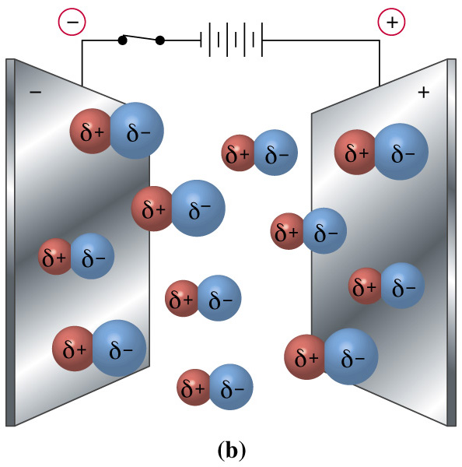
When placed in an electric field polar molecules would become aligned.

Slide 6
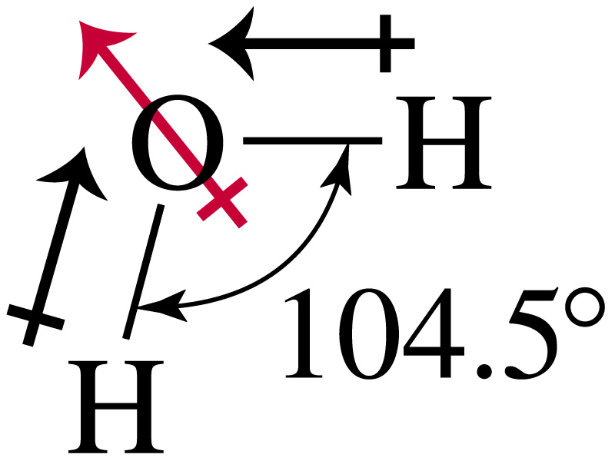
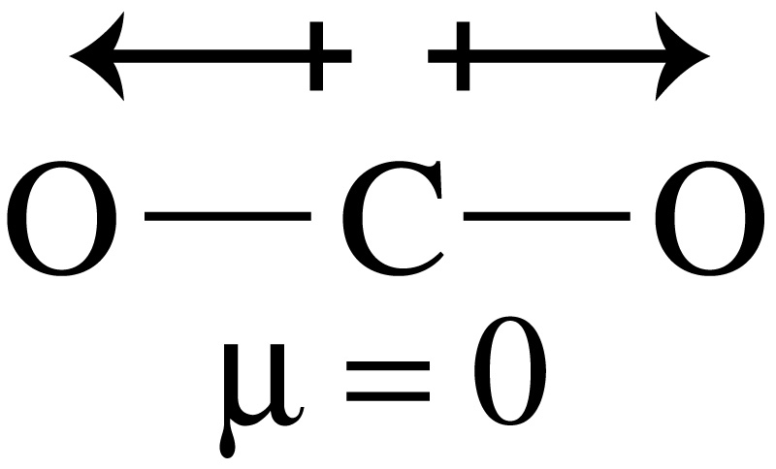
THE POLARITY OF MOLECULES
To decide on the polarity of a molecule we must consider the polarity of each of the bonds added together ie the vector sum of the dipoles.
If the sum of the dipoles is zero then the molecule is non-polar. Hence it is possible to have polar bonds within a non-polar molecule
Eg.1 CO₂ is linear and the two polar bonds are of equal strength. Since they exactly oppose one another, they cancel each other and the molecule as a whole is non-polar.
Eg.2 H₂O is bent. The two polar bonds are of equal strength but do not cancel each other – the is a net dipole and the molecule as a whole is therefore polar.

Slide 7
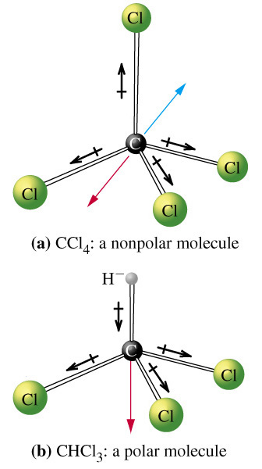
More Examples
Eg.4 CHCl₃ is tetrahedral but the four polar bonds are of not of equal strength. Despite being at 109.5º to each other, they do not cancel each other – there is a net dipole and the molecule as a whole is polar.
Eg.3 CCl₄ is tetrahedral and the four polar bonds are of equal strength. Since they exactly geometrically balanced (at 109.5º to each other), they cancel each other and the molecule as a whole is non-polar.

Slide 8
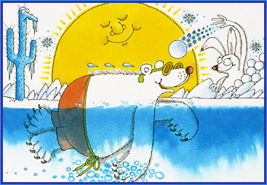
Polar Bears
+
+
Negative end of bear attracts positively charged snowball.

